Slide 1
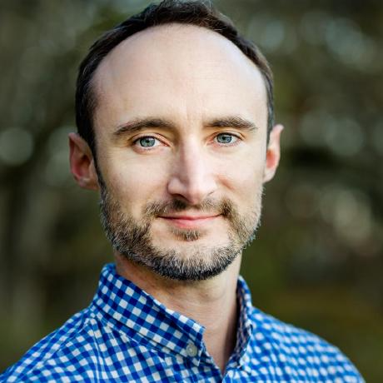
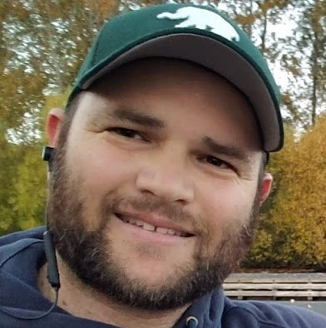
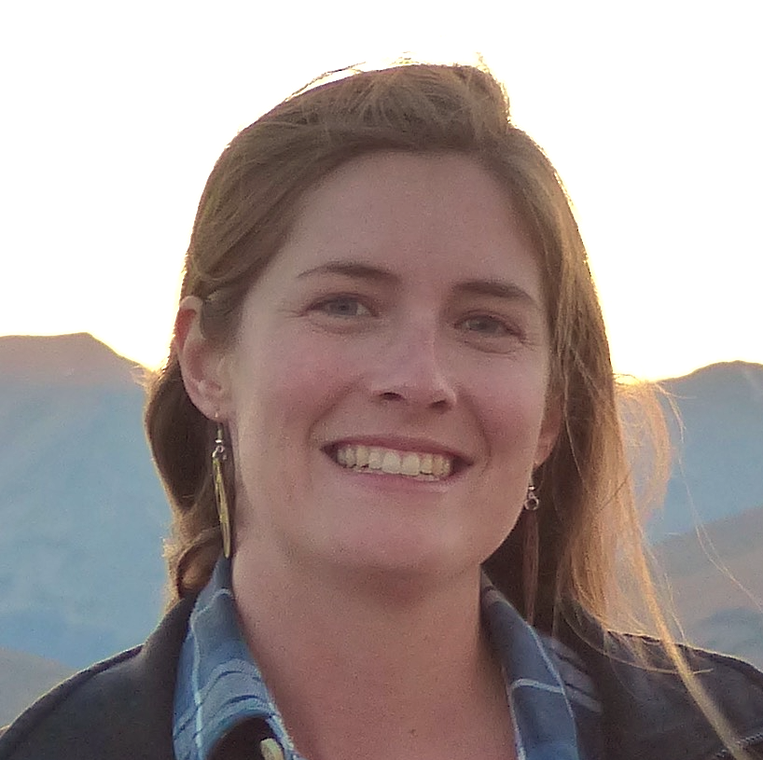
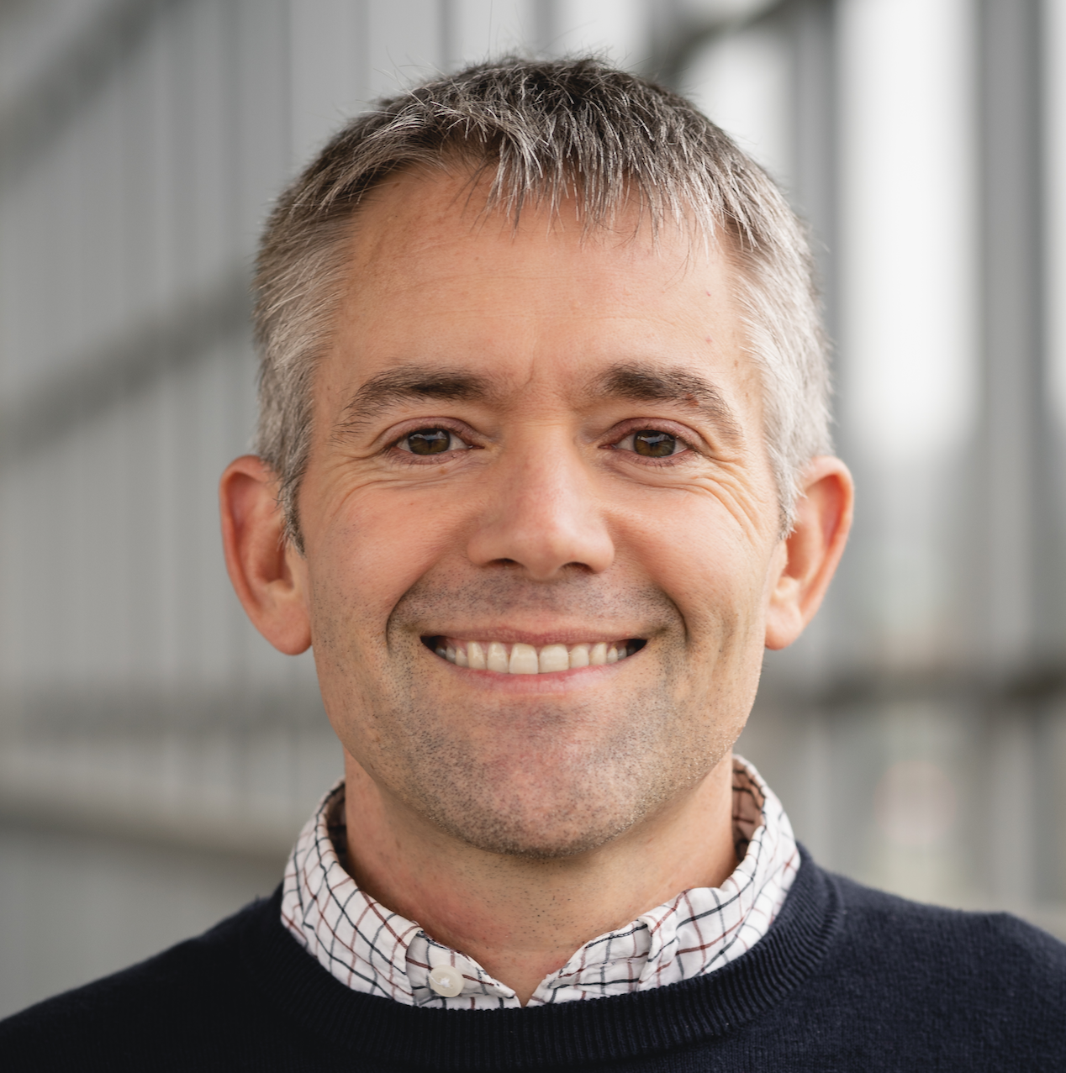
Sean Anderson
Pacific Biological Station (DFO)
Lewis Barnett
Alaska Fisheries Science Center (NOAA)
Philina English
Pacific Biological Station (DFO)
Eric Ward
Northwest Fisheries Science Center (NOAA)

